Slide 1


What percentage of businesses across the UK use some form of cloud service? (Teams, Microsoft 365, AWS etc.)
Notes:
69% in 2023
Approximately 69% of UK firms used cloud-based computing systems in 2023, according to the Office for National Statistics (ONS)

Slide 2
What do we know now?
What is a virtual machine?
What’s an advantage of virtualisation?
True or false: One computer can run several virtual machines at once
What is cloud computing?

Slide 3

Learning Objectives
Understand components and characteristics of virtual and cloud envrironments
Explain benefits and drawbacks of using virtual environments
Compare different types of cloud environments and delivery models
Analyse which model best fits different organisational scenarios

Slide 4

Virtualisation
Cloud Types
Cloud Service Models
End users

Slide 5
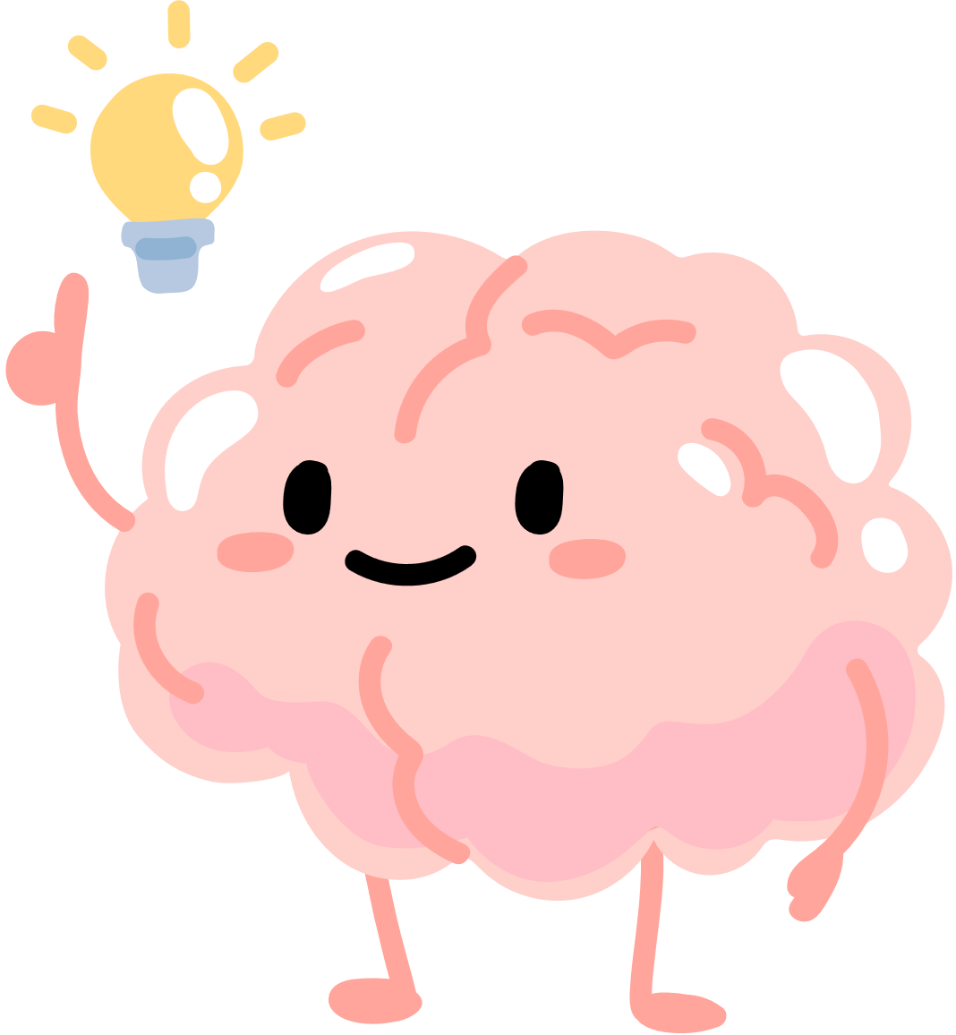
What is virtualisation?
We already know that a physical computer has a CPU, memory, and storage

Slide 6

But what if we could get 1 machine to act like 10?
What reasons do you think a business might want one computer to act like many?
Notes:
Cost savings
Scalability (able to increase quickly)
Efficiency by using resources more effectively
Increased flexibility as can adjust resources when needed i.e. give a machine more ram if needed
Simplifies disaster recovery by making machines easy to restore
Can decrease energy usage
Can decrease risk of hardware failure

Slide 7
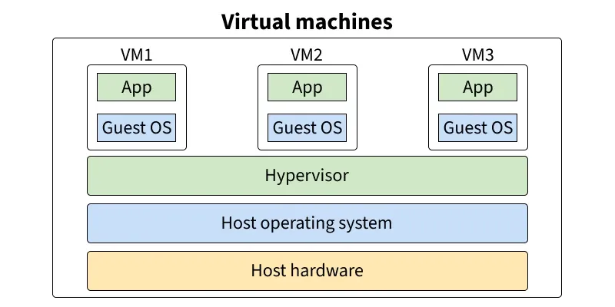
What does it look like?
Notes:
Data flow
Host
Hypervisor
VM

Slide 8
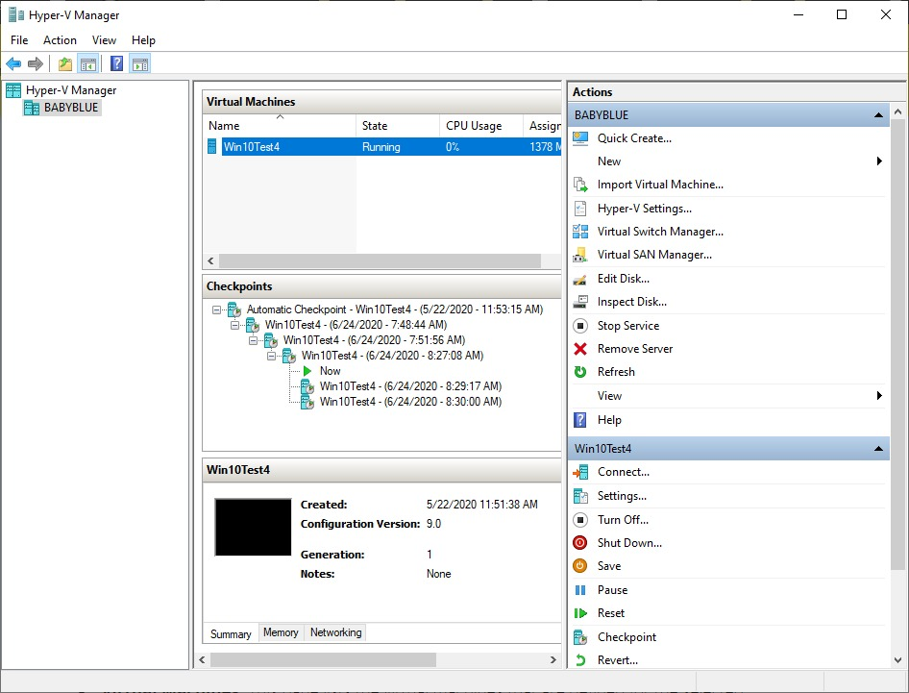
What does it look like?

Slide 9
There are several components that make up virtualisation
Host machine (Physical)
Hypervisor
Virtual Machines (VM’s)
Virtual Switches and routers
Client and server VM’s
Guest OS
Notes:
Host machine: The real computer, has CPU, RAM, storage
Hypervisor: The software that manages and runs the VM's
Virtual Machines: A pretend PC inside another PC
Virtual switches/routers: Software based versions of physical switches/routers that allow the VM's to talk to each other
Client and server Virtual machines: Clients requesting resources, servers providing them
Guest OS: an OS installed within a virtual machine that runs on the host machine
Hypervisor: Hotel manager, allocates rooms (resources) to guests (vm's)
VM: a flat in a block, independent but sharing the same building

Slide 10
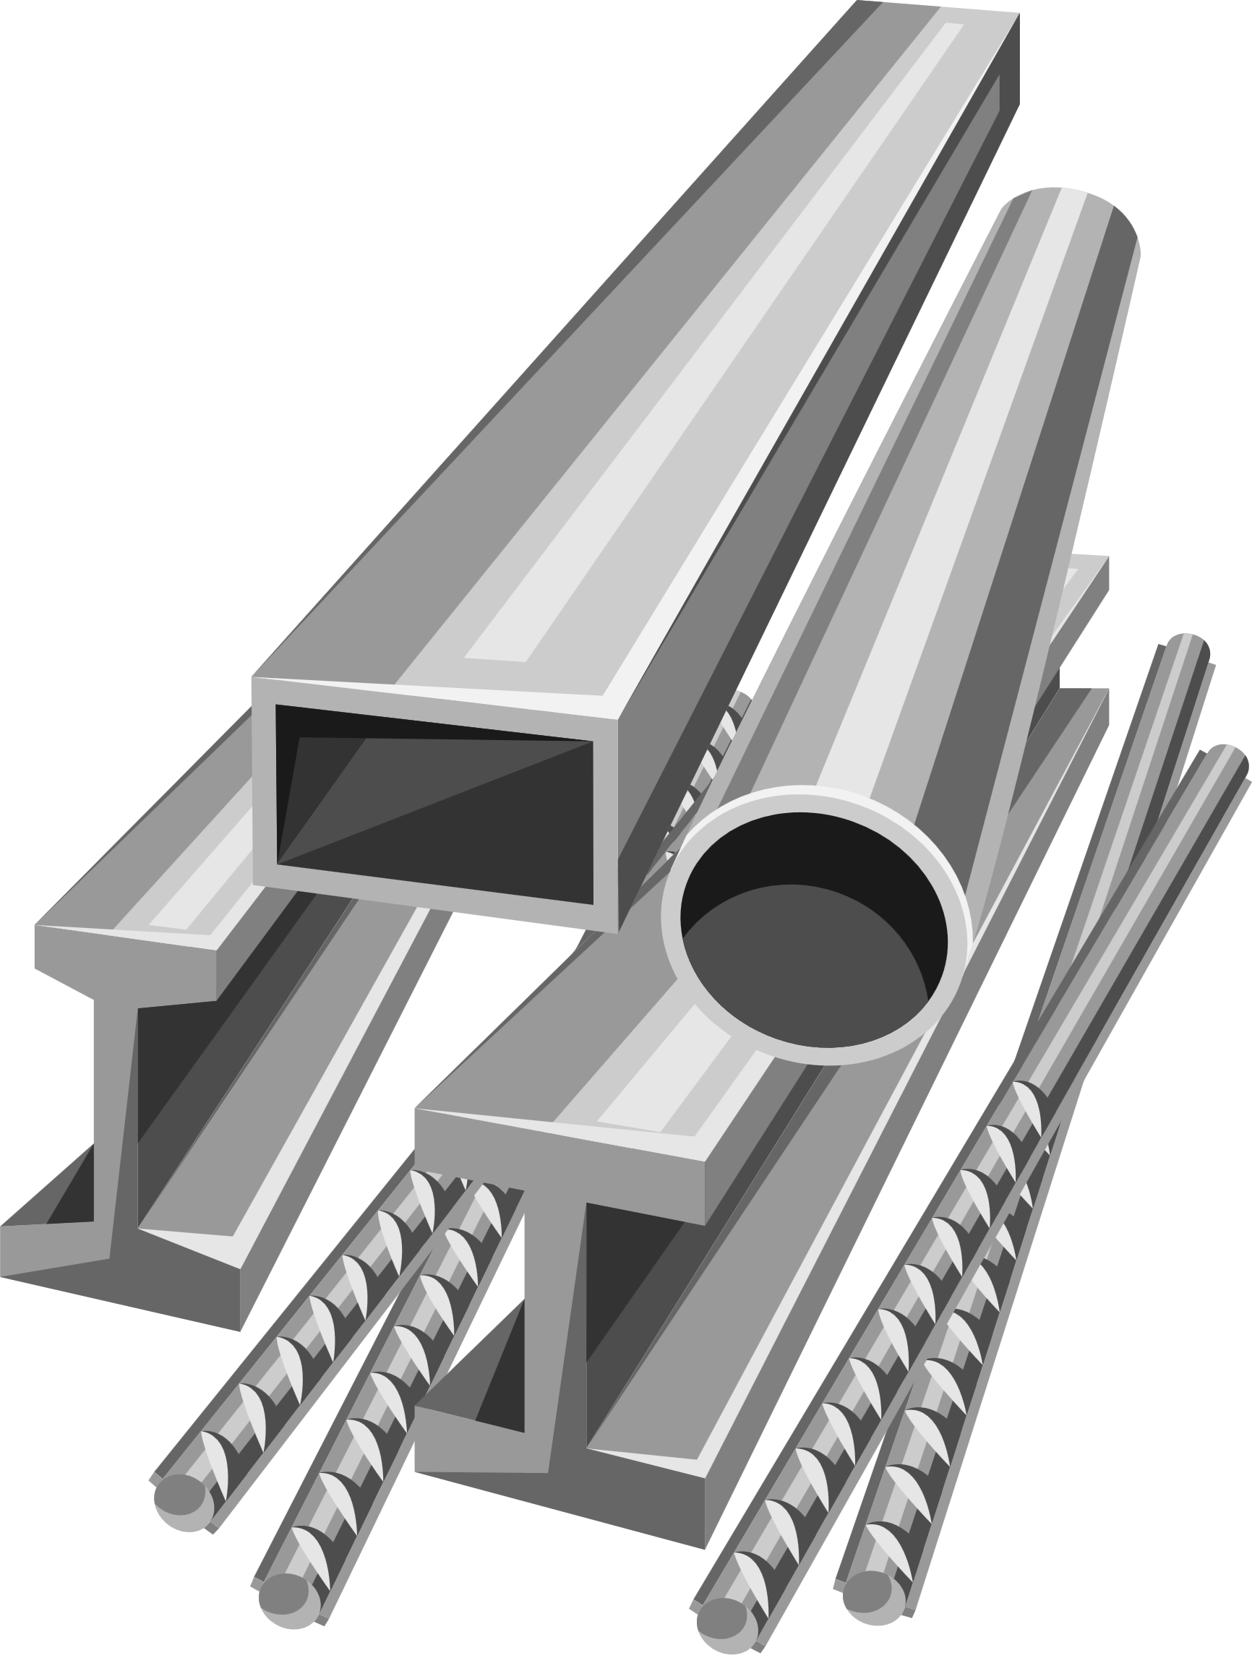
Hypervisor Type 1: Bare Metal
Runs directly on the hardware
Used in data centres and professional setups
Examples: VMware ESXi, Microsoft Hyper V

Slide 11

Hypervisor Type 2: Hosted
Runs on top of another OS
Good for personal or small lab use
Examples: Oracle Virtual Box, VMware Workstation
Notes:
Check in questions:
Which would you use on your own laptop to run Linux?
Which would you use to create a virtual server for a database?

Slide 12

Why might IT Engineers prefer to use virtual machines over physical machines?

Slide 13

Activity 1 - Virtualisation in practice
You’re going to match the key features and benefits of virtual environments to real-life examples.
This will show how virtualisation helps businesses, and when it can cause issues.
Go to the Digital Environments section in onenote and open ‘Virtualisation and Cloud Worksheet’
Notes:
Links to learning objective 1

Slide 14
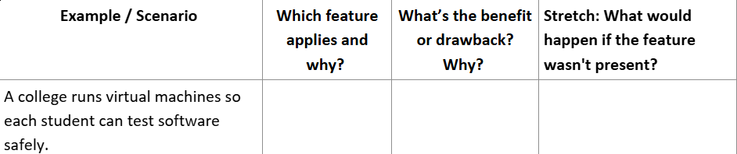
Notes:
Isolation: Safer Testing
Sharing: Efficient use of resources
Aggregation: Lower cost by combining workloads
Emulation: Can easily test other OS's like Linux without needing to install
Portability: Easy migration if hardware being upgraded etc.
Managed Execution: More stable performance
Increased security: Limits the attack spread
Questions: What example did we use for this feature?

Slide 15
Key features
Isolation | Each VM is separated
Sharing | Many VM’s share one host’s resources
Aggregation | Combining workload on one host
Emulation | Pretending to be another OS
Portability | Move VM’s between hosts
Managed Execution | Hypervisor controls how VM’s use CPU/RAM
Increased security | Linked to isolation
Notes:
Isolation: Safer Testing
Sharing: Efficient use of resources
Aggregation: Lower cost by combining workloads
Emulation: Can easily test other OS's like Linux without needing to install
Portability: Easy migration if hardware being upgraded etc.
Managed Execution: More stable performance
Increased security: Limits the attack spread
Questions: What example did we use for this feature?

Slide 16
What are some of the benefits and drawbacks of virtualisation?
Discuss with the people next to you
Notes:
Cost effectiveness: Less hardware spend
Easy management: Central control via hypervisor tools
Resilience and disaster recovery: snapshot/restore in minutes
Lower carbon footprint: Less power/less waste
Testing and training: safe spaces for students and developers

Slide 17

Benefits
Cost effectiveness
Easy management
Resilience and disaster recovery
Lower carbon footprint
Testing and training
Notes:
Cost effectiveness: Less hardware spend
Easy management: Central control via hypervisor tools
Resilience and disaster recovery: snapshot/restore in minutes
Lower carbon footprint: Less power/less waste
Testing and training: safe spaces for students and developers

Slide 18

Drawbacks
Extra hardware load
Slower execution time
False performance results
Which of these could cause issues for our developer example?
Notes:
Extra hardware load: Each VM still uses a CPU. Too many equals strain
Slower execution time: Shared resources can equal lower performance
False performance results: Tests inside a VM may not equal real-hardware results

Slide 19

Activity 2 - If I were the IT manager
Imagine you’re the IT manager of a small business
You can either:
Set up 5 physical servers, or use 1 large host with several VM’s
Write a short note to your boss explaining which you’d choose and why. Include one benefit and one drawback
Notes:
Extra hardware load: Each VM still uses a CPU. Too many equals strain
Slower execution time: Shared resources can equal lower performance
False performance results: Tests inside a VM may not equal real-hardware results

Slide 20
You’ve just decided how to virtualise your business’s servers.
But what if you didn’t want to own any of that hardware at all?
What if another company hosted those machines for you?
Notes:
Extra hardware load: Each VM still uses a CPU. Too many equals strain
Slower execution time: Shared resources can equal lower performance
False performance results: Tests inside a VM may not equal real-hardware results

Slide 21

That’s where cloud environments come in
Notes:
Who can tell me the difference between a virtual environment and a cloud environment in one sentence

Slide 22


Traditional | Virtualised | Cloud
One OS per physical server | Many virtual machines on one host | Virtual machines and software delivered online by a provider
Notes:
When virtual machines go to the cloud, where does the hardware live now?

Slide 23

Private Cloud
Used by one organisation only, and owned/controlled internally
example: A college’s internal cloud for student data
Notes:
Policy
Procedure
Policy
What problem do they prevent?
What system or data does it protect?

Slide 24

Public Cloud
Services offered over the internet to many customers
example: AWS, Azure, Google Cloud
Notes:
Policy
Procedure
Policy
What problem do they prevent?
What system or data does it protect?

Slide 25

What are the benefits of moving to the cloud?
Notes:
Benefits:
Cost effective
Scales easily
Resilient (backups/recovery)
Portable (access anywhere)
Sustainable
Easy to manage
Drawbacks:
Slower performance, security risks, less control, internet dependency

Slide 26

What might the drawbacks be?
Notes:
Drawbacks:
Slower performance, security risks, less control, internet dependency

Slide 27
A small start up can’t afford servers. What benefit matters the most?
A hospital needs 24/7 access, even during local outages. What benefit might that be?
A student wants to access coursework at home. Which feature might this be?

Slide 28
The cloud has some major benefits, but a few risks.
We’re going to take a look at different cloud models and how they manage those responsibilities

Slide 29
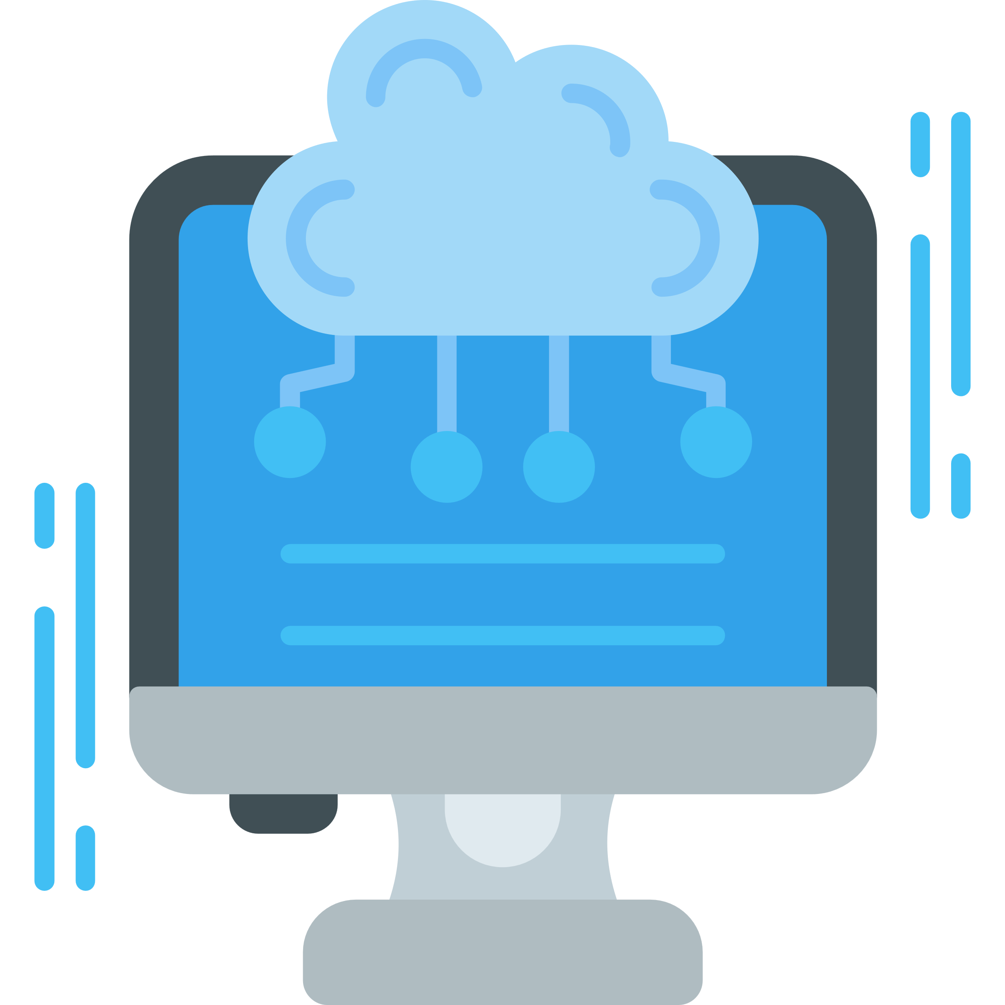
Infrastucture as a service (IaaS)
Renting virtualised infrastructure such as servers, storage and networking
Client looks after: Operating system, runtime, data and apps
Examples: Azure VM’s, Amazon EC2, Google Compute, Websites
Notes:
Provider manages: Hardware, storage and virtualisation
Typical users: Network admins, system engineers and back end developers

Slide 30
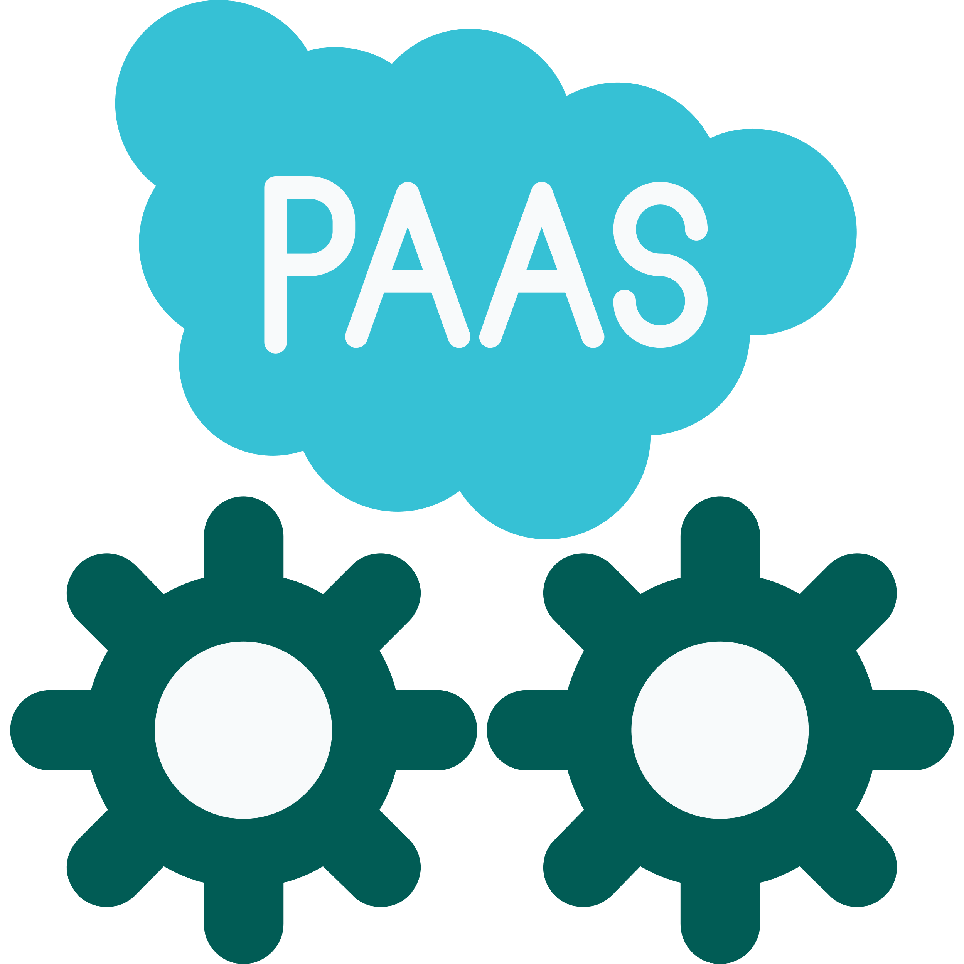
Platform as a service (PaaS)
Renting both the infrastructure and platform tools (API’s etc.) to build and deploy software
Client looks after: Applications, data, user accounts
Examples: Google app engine, Microsoft Azure App service, Heroku
Notes:
Provider manages: Hardware, OS, runtime and middleware
Typical users: Software developers building and testing applications

Slide 31

Software as a Service (SaaS)
Fully managed applications provided over the internet
Client looks after: User data and accounts
Examples: Microsoft 365, Google Workspace, Salesforce, Zoom
Notes:
Provider manages everything else : infrastructure, OS, apps
Typical users: End users, businesses and individuals

Slide 32
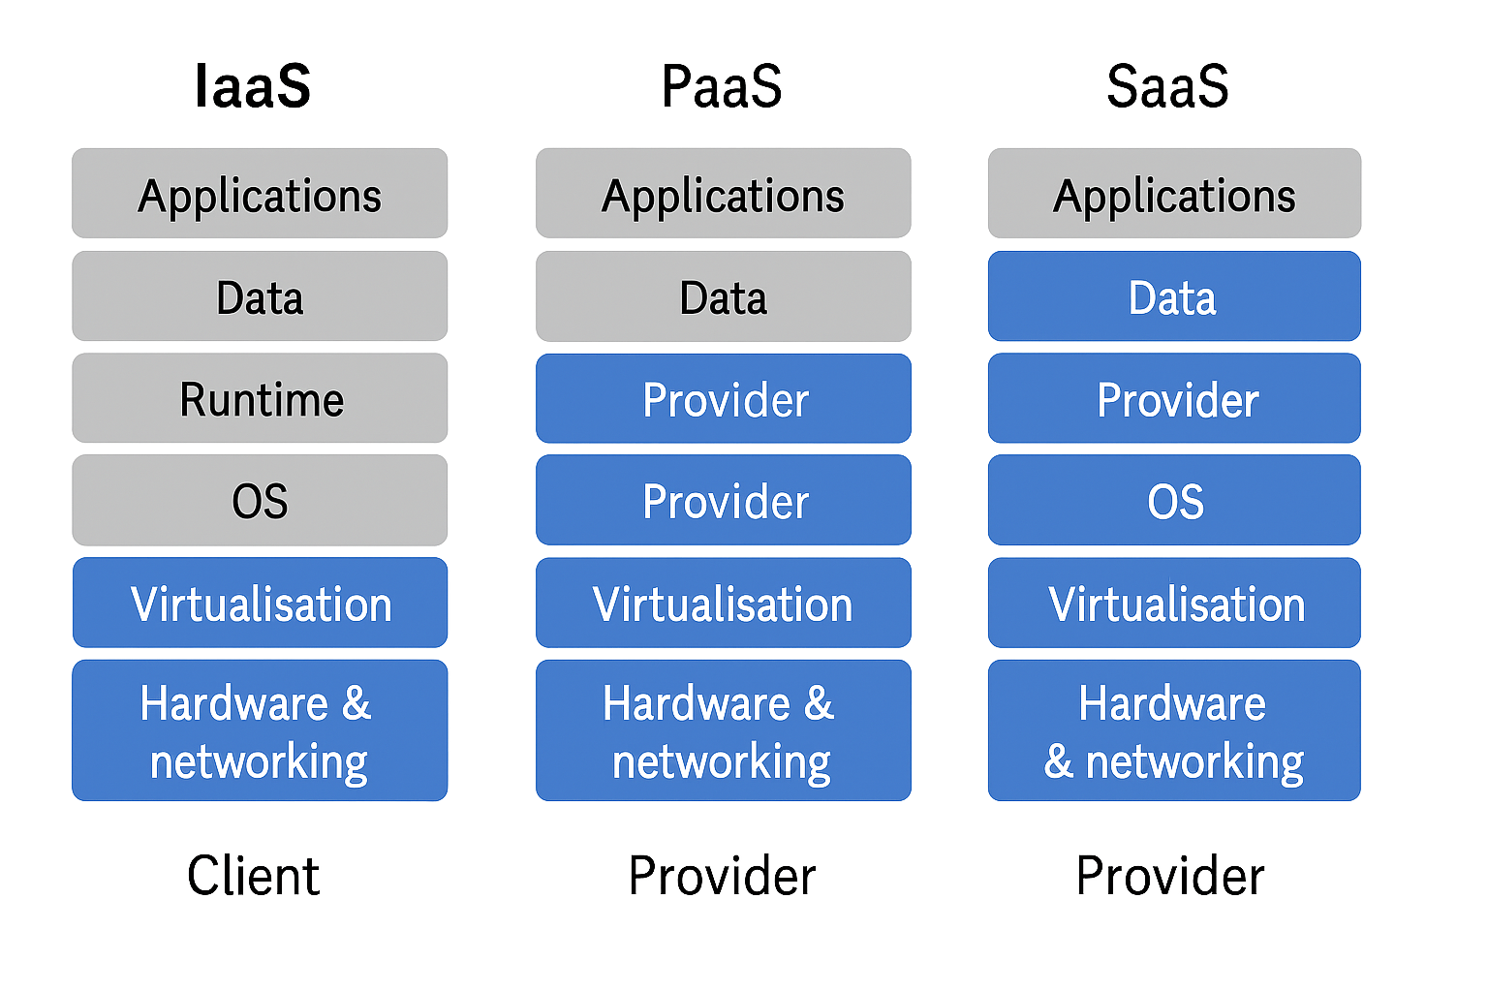
Notes:
Provider manages everything else : infrastructure, OS, apps
Typical users: End users, businesses and individuals

Slide 33
Quick decision task: what models would be best?
🧠
Developer team testing an app
Small business using emails and docs
Enterprise building a custom data centre
Notes:
1: PaaS, They can deploy quickly without managing servers
2: SaaS, they just need to log in and use it
3. IaaS, They need full control over the environment
Stretch: Why might using all 3 models together be more efficient than relying on just one?
Answer: Each layer handles a different part of IT. Together they reduce cost, increase flexibility and let each team focus on what they're best at

Slide 34
Virtualisation
Cloud Types
Cloud Service Models
End users

Slide 35

Reflection
If you were building your own software service, which environment would you choose?
Virtual or cloud? Why?
Write 2-3 sentences in your Onenote

